Slide 1

Building a Better Kickstarter Project
Springboard Capstone Project #1
Tom Halloin

Slide 2
About Kickstarter
Crowdfunding projects
As of May 2019 (according to Wikipedia):
$4 billion in pledges
16.3 million backers
445,000 projects funded
Projects only receive funding if exceeded goal.
Goal: use machine learning techniques to improve project approval likelihood

Slide 3
Data Source
Data source comes from scraping JSON files at https://webrobots.io/kickstarter-datasets/
January 2016 – April 2019 JSON files
Files contain scrapes from projects as early as April 2009
430,714 projects after removing duplicates

Slide 4
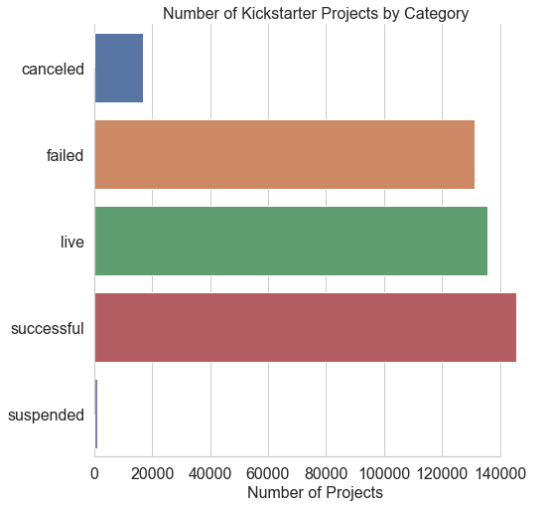
Deciding Project “Success”
Reducing 5 categories to 2 (only care if project passes funding goal or not.)
Most “live” projects have passed funding deadline
Combining all fields outside of “successful” leads to 60% failed / 40% success split

Slide 5
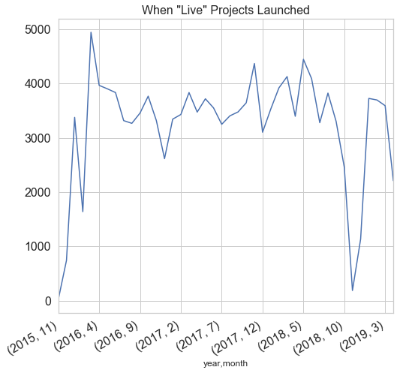
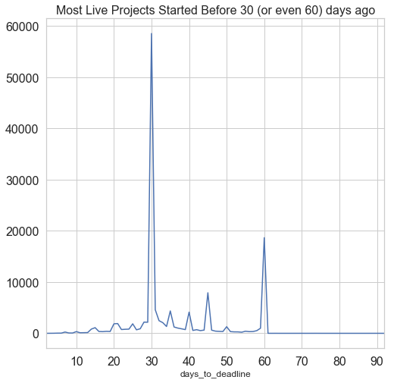
Most Live Projects Aren’t that “Live”

Slide 6

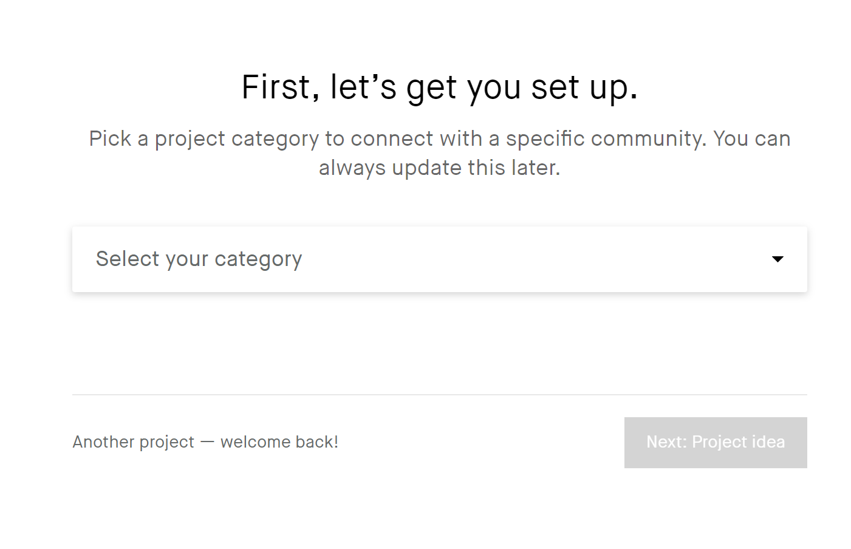
Optimizing the following:
Title
Category
Goal
Location
Timing
Product Ideas

Slide 7
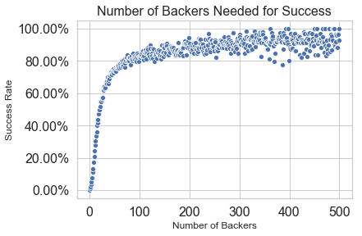
More Backers -> Higher Success

Slide 8
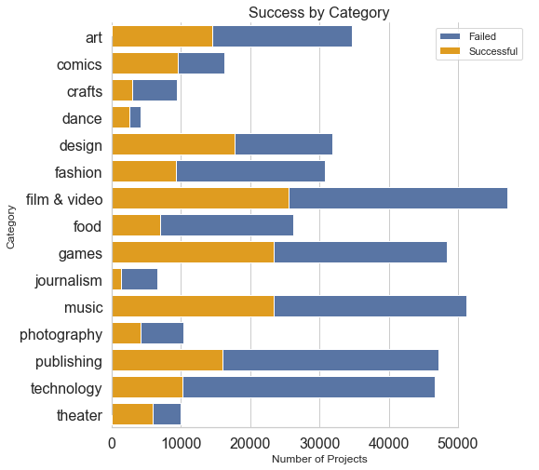
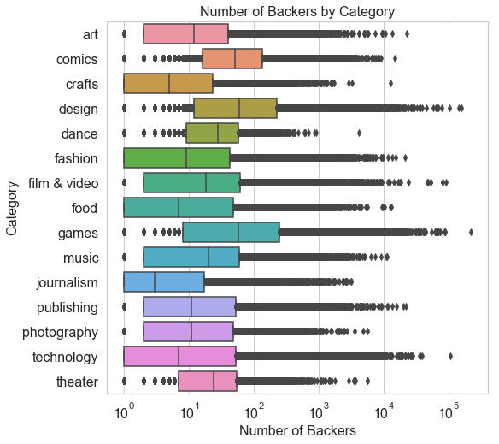
Exploring the Data: Categories

Slide 9
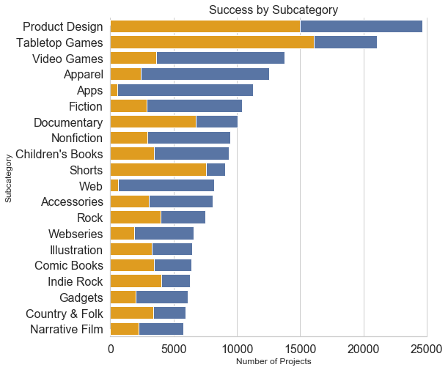
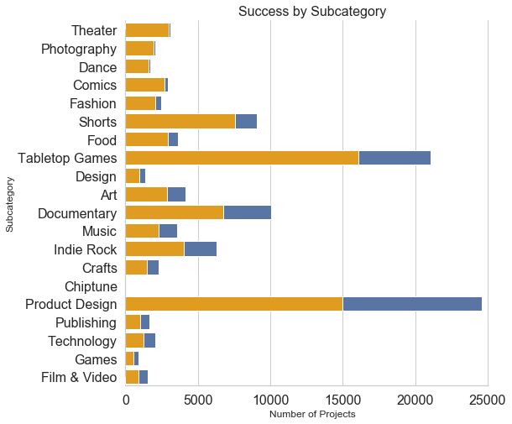
Exploring the Data: Subcategories

Slide 10
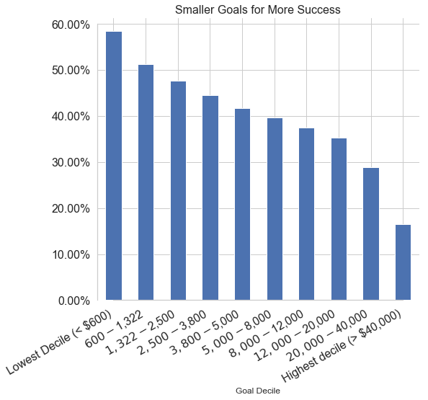
Exploring the Data: Funding Goal

Slide 11
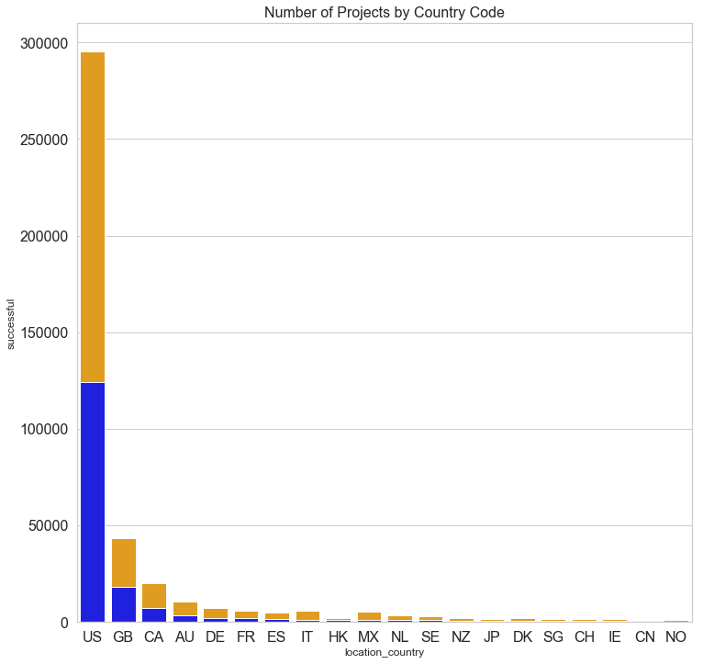
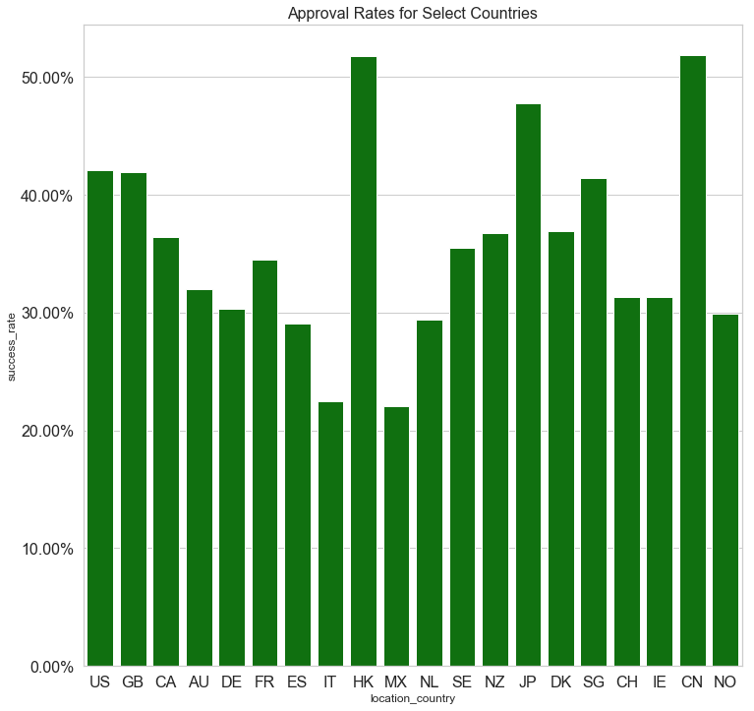
Exploring the Data: Location

Slide 12
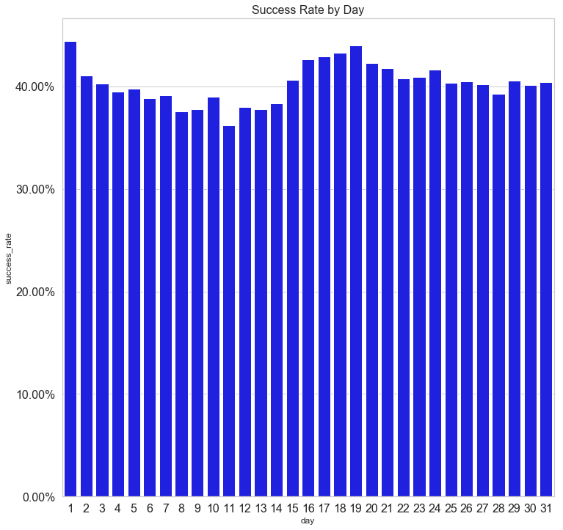
Exploring the Data: Timing
Peaks at 1st of month, then around mid-month
Coincides with paycheck schedule: Most Americans receive paychecks 1st of month, then one about two weeks later.

Slide 13
Machine Learning Models
Logistic Regression
Common for binary classification problems
Naïve Bayes
Predicts approval likelihood given word in title or blurb
Random Forest:
Builds several “weak” decision trees to build strong final model
Stochastic Gradient Descent:
Large scale logistic regression with more tuning parameters
XGBoost:
Random Forest with more tuning parameters

Slide 14
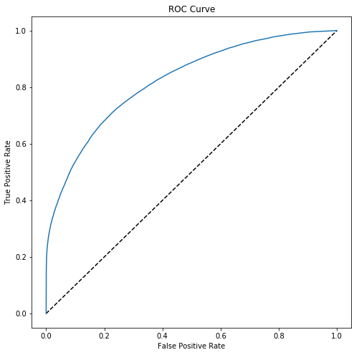
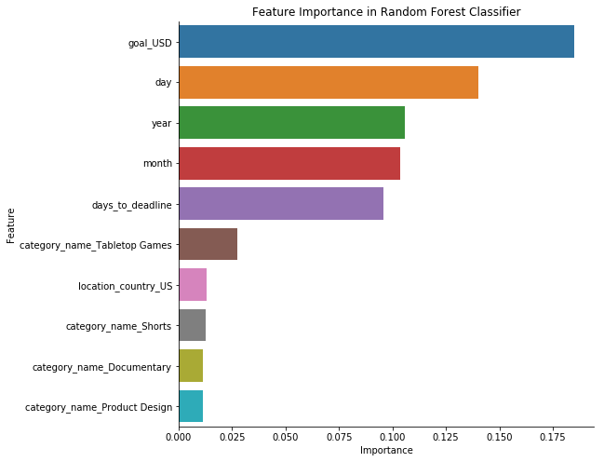
Best Model: Random Forest ~ 75% testing accuracy

Slide 15
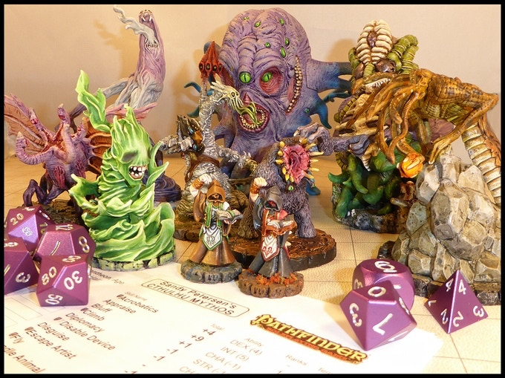
Popular Words from Naïve Bayes model
Probability | Word
miniatures 0.87
printable 0.86
cthulhu 0.86
pathfinder 0.82
titanium 0.81
edc 0.80
terrain 0.79
dice 0.76
miniature 0.76
stretch 0.76
Sandy Petersen’s successful Cthulhu Mythos for Pathfinder project raised over $200,000. See project here.

Slide 16
Recommendations
Start with a small goal (~$500). Think about projects to sell to 20 of your friends for $25 each once they have received their paychecks and paid their bills.
Categories without a lot of success included apps, websites, and journalism. Issue: access to free alternatives.

